Slide 1
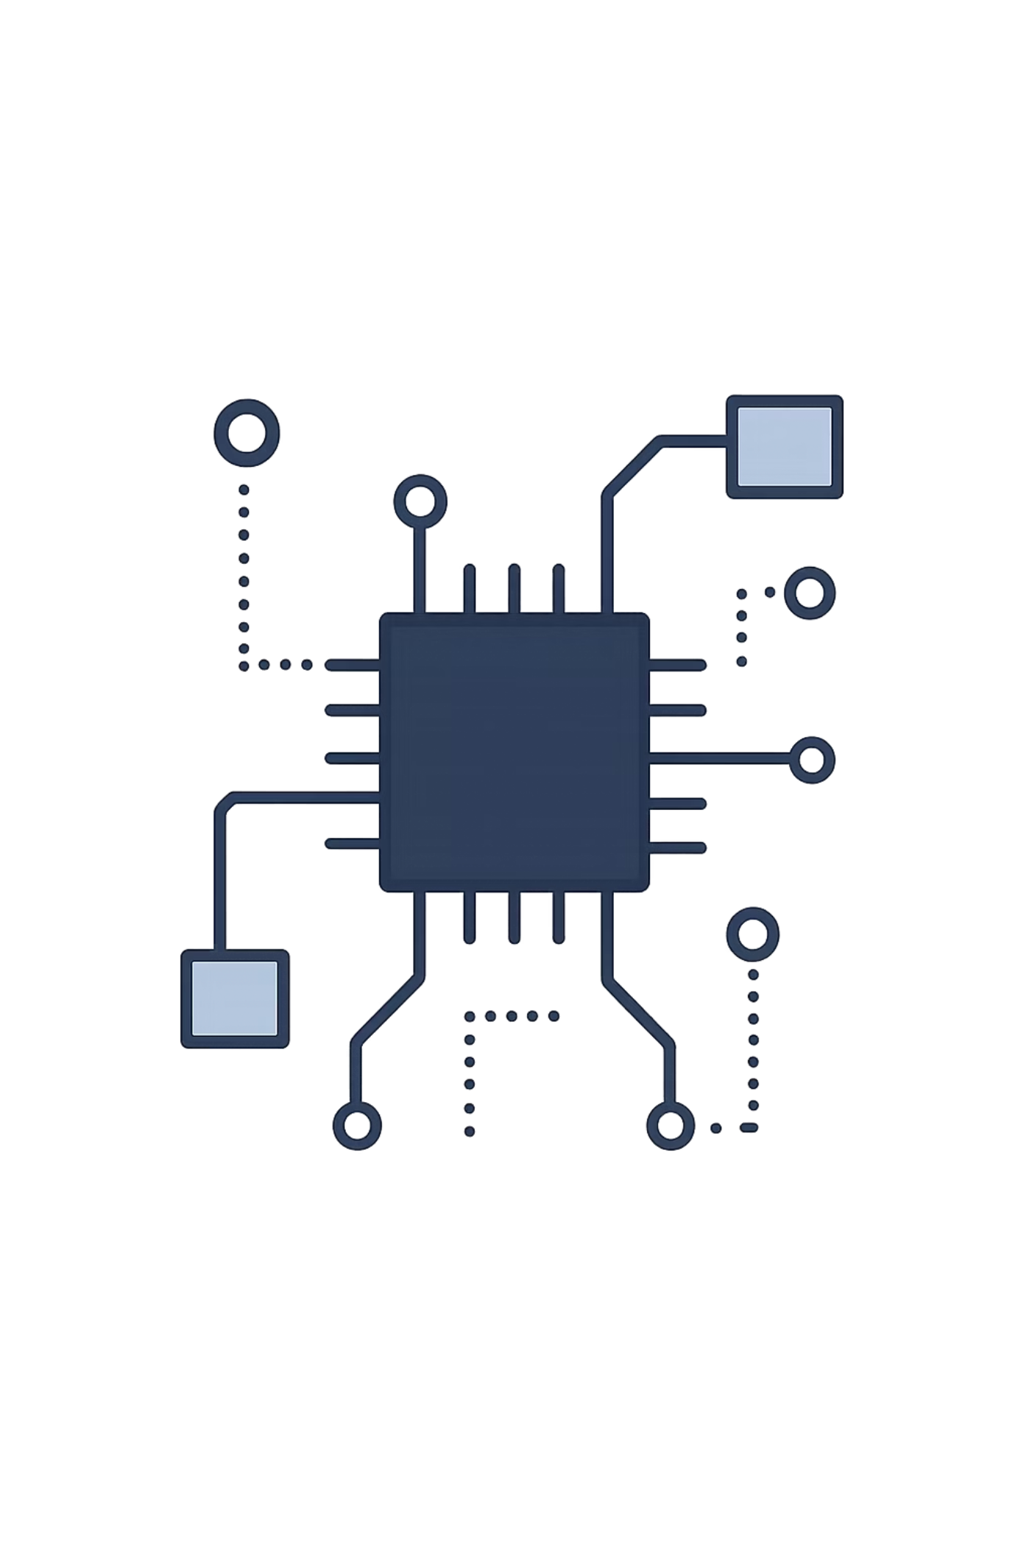
MERN Stack & React JS Foundations
Your hands-on introduction to Full Stack Development — from architecture to your first interactive React application.
BOOTCAMP SESSION
REACT FUNDAMENTALS

Slide 2
Session Goals
By the end of this session, you will be able to:
01
02
Understand the Stack
Learn React Core Concepts
Grasp Full Stack concepts and MERN architecture end-to-end.
Components, props, state, JSX — the building blocks of every React app.
03
04
Set Up Your Environment
Build Reusable Components
Install Node.js, npm, and VS Code. Get your machine dev-ready.
Apply concepts hands-on — create dynamic, data-driven UI components.

Slide 3


PREREQUISITES
What You Should Know Before React
React builds on core JavaScript. Make sure you are comfortable with:
Async basics (Promises, async/await) are optional but helpful.
JS Fundamentals
ES6 Syntax
DOM & Events
Variables, functions, arrays, and objects.
Arrow functions, destructuring, and the spread operator.
Basic DOM manipulation and event handling in the browser.

Slide 4
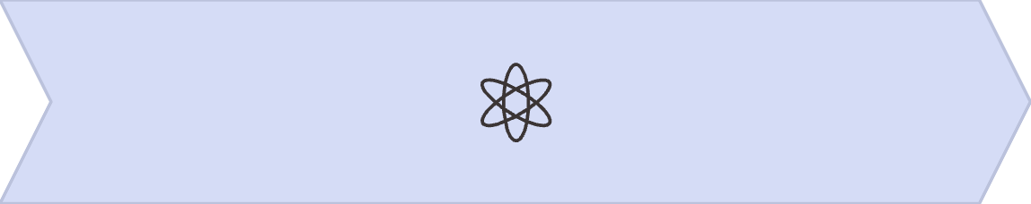
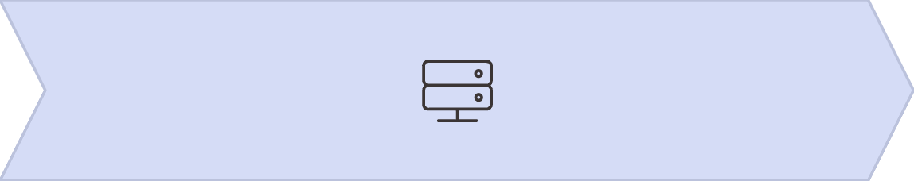
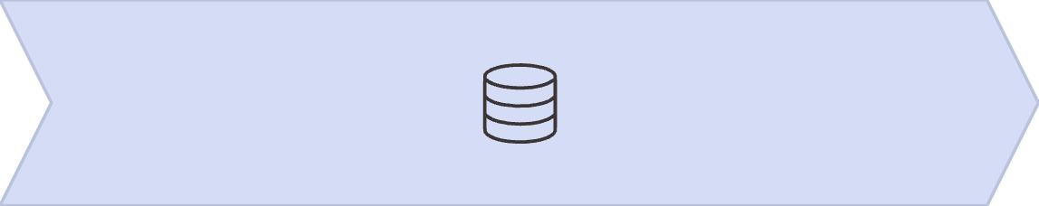
ARCHITECTURE
Full Stack Architecture
The MERN stack covers every layer of a modern web application — from the database to the browser.
React
Node.js + Express
MongoDB
Frontend UI — what users see and interact with.
Backend runtime and framework — handles API logic and routing.
NoSQL database — stores and retrieves application data.

Slide 5
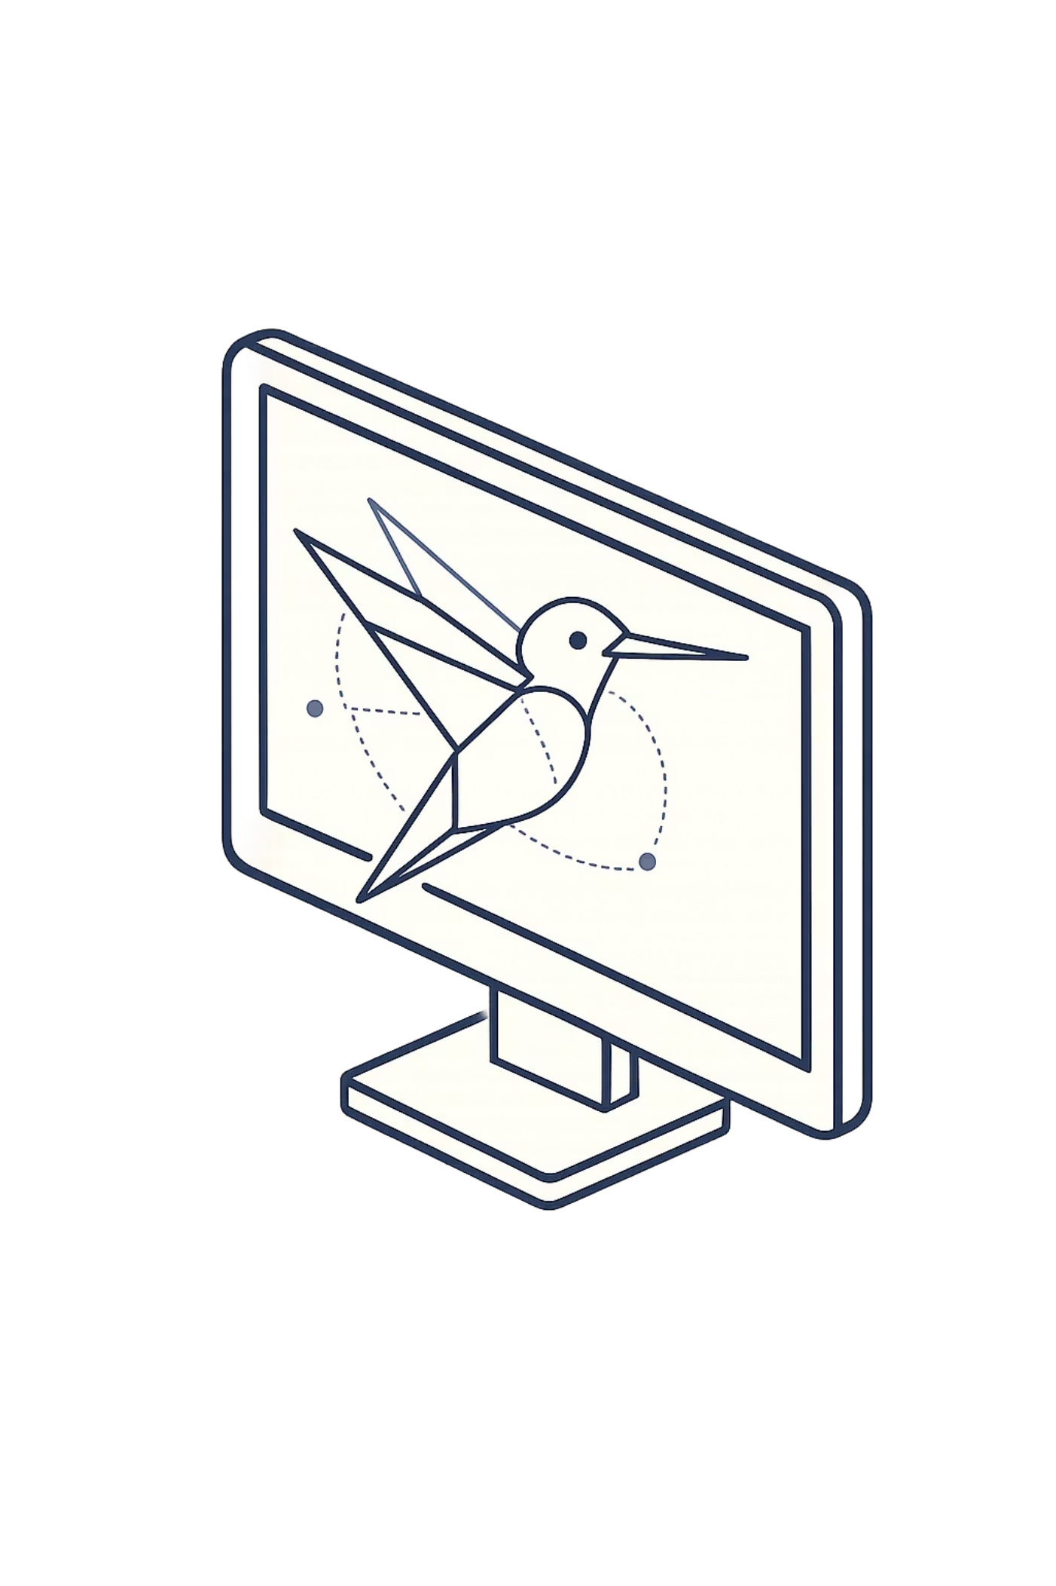
What is React?
React is a JavaScript library developed by Meta for building fast, dynamic user interfaces. It powers apps you use every day — Instagram, Netflix, and more.
Component-Based
Declarative
Build encapsulated pieces of UI and compose them into complex apps.
Describe what the UI should look like — React handles the updates.
Fast by Design
The Virtual DOM ensures only what changed gets re-rendered.

Slide 6
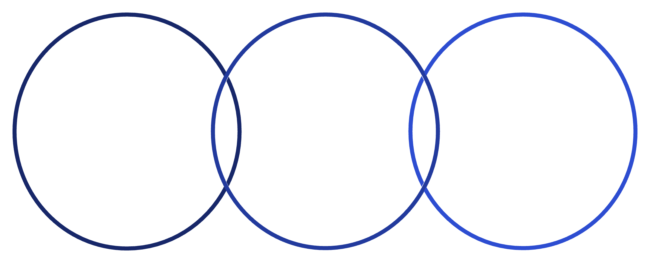
How React Works
Single Page Application
Traditional websites reload the entire page on every navigation. React apps update only the relevant content, making interactions feel instant and seamless.
SPA
Virtual DOM
Overlap
No full page reload; updates only content
In-memory DOM copy that diffs changes
Efficient updates for seamless interactions
Virtual DOM
React keeps a lightweight copy of the DOM in memory. On every state change, it diffs the old and new trees and applies only the minimal set of real DOM updates — a major performance win.

Slide 7

DEMO
Setup Development Environment
Before creating a React app, ensure these tools are installed on your machine.
1
2
3
Install Node.js
Verify Installation
Install VS Code
Download from nodejs.org. This includes npm automatically.
Open your terminal and run the verification commands below.
Download from code.visualstudio.com — your primary code editor.
node -v
npm -v
✅ If both commands return version numbers, your system is ready for React development.

Slide 8

DEMO
Create Your First React App
Run These Commands
What You Get
A fully working React app in seconds
Hot reload — changes reflect instantly in the browser
npx create-react-app my-app
cd my-app
npm start
React will scaffold a complete project structure and open your app automatically at http://localhost:3000.
Pre-configured Webpack, Babel, and ESLint
Ready-to-edit src/App.js as your entry point

Slide 9
React Core Concepts
JSX
Components
Props
Write HTML-like syntax directly inside JavaScript.
Functional or class-based — the reusable units of your UI.
Pass data from parent to child components.
State
Events
Manage dynamic data that triggers re-renders when updated.
Handle user interactions like clicks, inputs, and form submissions.

Slide 10
Hands-on Activity & Key Takeaways
ACTIVITY
TAKEAWAYS
Build It Yourself
What You Learnt Today
Create a React app with two reusable components — Student and Course — that accept props and render dynamic output.
MERN stack architecture and each layer's role
React fundamentals — JSX, components, props, state
function Student(props) {
return <h1>Hello {props.name}</h1>;
}
Dev environment setup and first app creation
Ready for Hooks, Routing, and APIs next!
Goal: An institute portal that displays student and course details dynamically using props-driven components.

